Slide 1

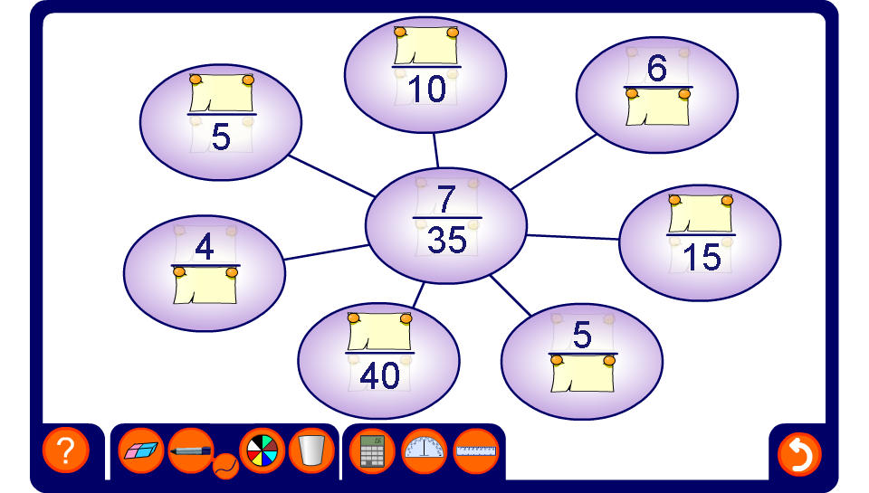


Equivalent fractions spider diagram
Notes:
Tell pupils that all the fractions on the board are equivalent to the one in the centre. Ask them to use proportional reasoning to work out the hidden numerators and denominators.
Stress that every fraction on the board is exactly the same fraction written in a different way. Establish that there are infinitely many ways to write the same fraction.
When all of the equivalent fractions have been revealed, ask pupils how we could convert between any two given fractions on the board by multiplying and/or dividing the numerator and the denominator by the same number.
Ask pupils to give examples of other fractions that are equivalent to those on the board.

